Slide 1
Rashtreeya Sikshana Samithi Trust
RV College of Engineering®, Bengaluru.
(An Autonomous Institution Affiliated to VTU, Belagavi)
DEEP LEARNING

Slide 2
An Artificial Neuron
y₁
w_{1j}
y₂
w_{2j}
w_{3j}
f(x)
O
y₃
y_{i}
w_{ij}
Each hidden or output neuron has weighted input connections from each of the units in the preceding layer.
The unit performs a weighted sum of its inputs, and subtracts its threshold value, to give its activation level.
Activation level is passed through a sigmoid activation function to determine output.

Slide 3
Multilayer Perceptron (MLP)
Output Values
Output Layer
Adjustable
Weights
Input Layer
Input Signals (External Stimuli)

Slide 4
Types of Layers
The input layer.
Introduces input values into the network.
No activation function or other processing.
The hidden layer(s).
Perform classification of features
Features imply more layers may be better
The output layer.
Functionally just like the hidden layers
Outputs are passed on to the world outside the neural network.

Slide 5
Hidden Units
Hidden units are nodes that are situated between the input nodes and the output nodes.
Hidden units allow a network to learn non-linear functions.
Hidden units allow the network to represent combinations of the input features.

Slide 6
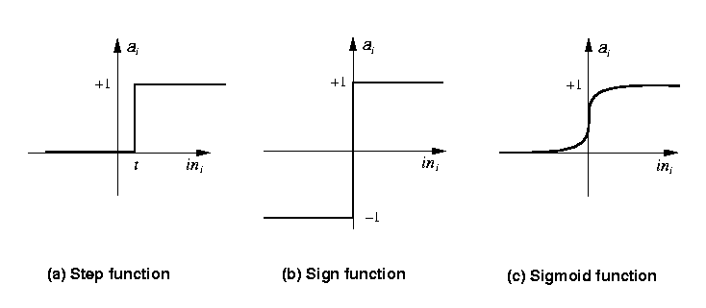
Activation functions
Transforms neuron’s input into output.
Features of activation functions:
A squashing effect is required
Prevents accelerating growth of activation levels through the network.
Simple and easy to calculate

Slide 7
Standard activation functions
The hard-limiting threshold function
Corresponds to the biological paradigm
either fires or not
Sigmoid functions ('S'-shaped curves)
The logistic function
The hyperbolic tangent (symmetrical)
Both functions have a simple differential
Only the shape is important
1
φ(x) =
1 + e ^{-ax}

Slide 8

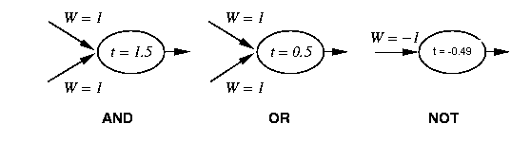
Perceptron Training
1 if Σ w_{i} x_{i} >t
Output=
0 otherwise
{
_{i=0}
Linear threshold is used.
W - weight value
t - threshold value

Slide 9
Simple network
AND with a Biased input
-1
W₁ = 1.5
X
W₂ = 1
t = 0.0
W₃ = 1
Y

Slide 10
Training Perceptrons
For AND
A B Output
0 0 0
0 1 0
1 0 0
1 1 1
-1
W₁ = ?
x
t = 0.0
W₂ = ?
W₃ = ?
y
What are the weight values?
Initialize with random weight values

Slide 11
Training Perceptrons
For AND
A B Output
0 0 0
0 1 0
1 0 0
1 1 1
-1
W₁ = 0.3
x
t = 0.0
W₂ = 0.5
W₃ =-0.4
y

Slide 12
Boolean functions
Perceptron can be used to represent the following Boolean functions
AND
OR
Any m-of-n function
NOT
NAND (NOT AND)
NOR (NOT OR)
Every Boolean function can be represented by a network of interconnected units based on these primitives
Two levels (i.e., one hidden layer) is enough!!!

Slide 13
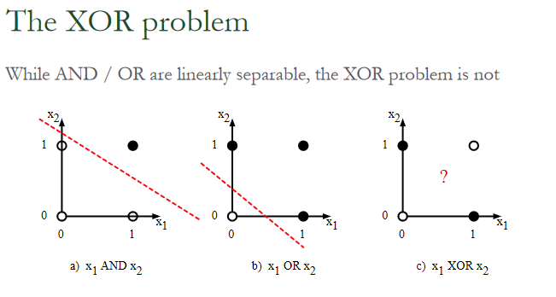

Slide 14
Perceptron: Linear Separable Functions
x₂
Not linearly separable
+
−
XOR
x₁
−
+
Minsky & Papert (1969)
Perceptrons can only represent linearly separable functions.

Slide 15
Minsky & Papert (1969) offered solution to XOR problem by
combining perceptron unit responses using a second layer of
Units. Piecewise linear classification using an MLP with
threshold (perceptron) units
+1
1
3
2
+1

Slide 16
Boolean XOR
XOR
o
0.5
X1 ⊕ X2
⇔ (X1 ∨X2) ∧¬(X1∧X2)
Not Linear separable →
Cannot be represented by a
single-layer perceptron
1
−1
OR
AND
0.5
h₁
h₂
1.5
1
1
Let’s consider a single hidden layer
network, using as building blocks
threshold units.
1
1
x₁
x₂

Slide 17
Deep Feedforward Networks
Deep feedforward networks feedforward , also often called neural networks, or multilayer perceptrons (MLPs), are the deep learning models.
The goal of a feedforward network is to approximate some function f ∗. For example, for a classifier,
y = f ∗(x) maps an input x to a category y.
A feedforward network defines a mapping y = f (x; θ) and learns the value of the parameters θ that result in the best function approximation.
These models are called feedforward because information flows through the function being evaluated from x, through the intermediate computations used to define f , and finally to the output y.
There are no feedback connections in which outputs of the model are fed back into itself. When feedforward neural networks are extended to include feedback connections, they are called recurrent neural networks,

Slide 18

The model is associated with a directed acyclic graph describing how the functions are composed together.
of the chain gives the of the model. It is from this depth terminology that the name “deep learning” arises. The final layer of a feedforward network is called the output layer.
During neural network training, we drive f(x) to match f ∗(x).
The training data provides us with noisy, approximate examples of f ∗(x) evaluated at
different training points. Each example x is accompanied by a label y ≈ f∗(x).

Slide 19
The training examples specify directly what the output layer must do at each point x; it must produce a value that is close to y.
The behavior of the other layers is not directly specified by the training data. The learning algorithm must decide how to use those layers to produce the desired output, but the training data does not say what each individual layer should do.
Instead, the learning algorithm must decide how to use these layers to best implement an approximation of f ∗. Because the training data does not show the desired output for each of these layers, these layers are called hidden layers

Slide 20
Each hidden layer of the network is typically vector-valued. The dimensionality of these hidden layers determines the width of the model
we can also think of the layer as consisting of many units that act in parallel,
each representing a vector-to-scalar function.
feedforward networks begin with linear models and consider how to overcome their limitations.
Linear models also have the obvious defect that the model capacity is limited to linear functions

Slide 21

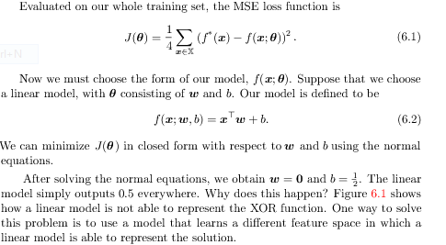
Example: Learning XOR
The XOR function provides the target function

Slide 22
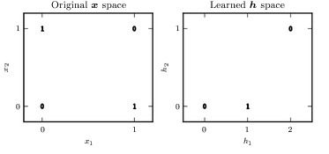
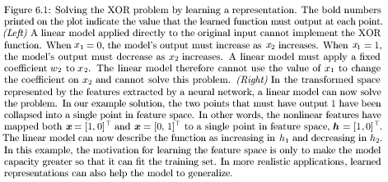

Slide 23
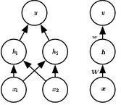
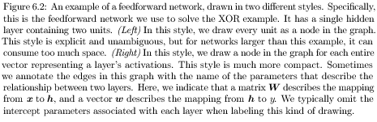

Slide 24
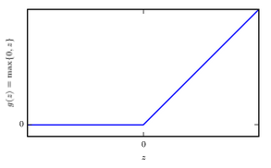
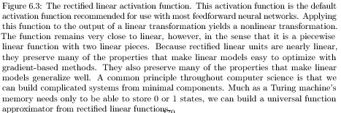

Slide 25
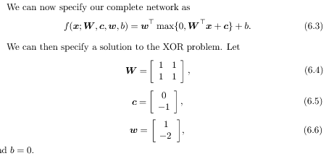
In modern neural networks, the default recommendation is to use the rectiﬁed linear unit , or ReLU

Slide 26
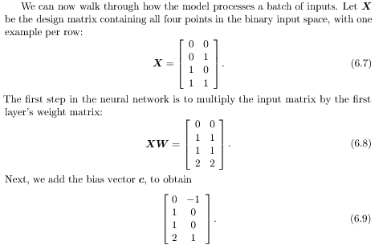

Slide 27
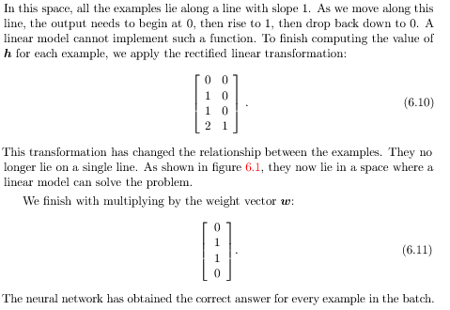

Slide 28
In this example, we simply speciﬁed the solution, then showed that it obtained zero error. In a real situation, there might be billions of model parameters and billions of training examples, so one cannot simply guess the solution as we did here. Instead, a gradient-based optimization algorithm can ﬁnd parameters that produce very little error. The solution we described to the XOR problem is at a global minimum of the loss function, so gradient descent could converge to this point. There are other equivalent solutions to the XOR problem that gradient descent could also ﬁnd. The convergence point of gradient descent depends on the initial values of the parameters. In practice, gradient descent would usually not ﬁnd clean, easily understood, integer-valued solutions like the one we presented here.

Slide 29
6.2 Gradient-Based Learning
Deep learning neural networks are trained using the stochastic gradient descent optimization algorithm. The learning rate is a hyperparameter that controls how much to change the model in response to the estimated error each time the model weights are updated
Gradient Descent is an optimization algorithm for finding a local minimum of a differentiable function. Gradient descent is simply used to find the values of a function's parameters (coefficients) that minimize a cost function as far as possible.
Computing the gradient is slightly more complicated for a neural network, but can still be done efficiently and exactly. Sec. 6.5 will describe how to obtain the gradient using the back-propagation algorithm and modern generalizations of the back-propagation algorithm.
As with other machine learning models, to apply gradient-based learning we must choose a cost function, and we must choose how to represent the output of the model. We now revisit these design considerations with special emphasis on
the neural networks scenario.

Slide 30
For the moment, it suﬃces to understand that the training algorithm is almost always based on using the gradient to descend the cost function in one way or another.
The speciﬁc algorithms are improvements and reﬁnements on the ideas of gradient descent,
most often improvements of the stochastic gradient descent algorithm, (introduced in section 5.9).
Computing the gradient is slightly more complicated for a neural network but can still be done eﬃciently and exactly - using the back-propagation algorithm and modern generalizations of the back-propagation algorithm.
6.2.1 Cost Functions: the cost functions for neural networks In most cases, our parametric model deﬁnes a distribution p(y | x;θ) and we simply use the principle of maximum likelihood
This means we use the cross-entropy between the training data and the model’s predictions as the cost function.
Sometimes, we take a simpler approach, where rather than predicting a complete probability distribution over y , we merely predict some statistic of y conditioned on x.

Slide 31
Most modern neural networks are trained using maximum likelihood. This means that the cost function is simply the negative log-likelihood, equivalently described as the cross-entropy between the training data and the model distribution.
An advantage of this approach of deriving the cost function from maximum likelihood is that it removes the burden of designing cost functions for each model. Specifying a model
P(y | x) automatically determines a cost function log p (y | x)
Note: https://towardsdatascience.com/probability-concepts-explained-maximum-likelihood-estimation-c7b4342fdbb1

Slide 32

6.3 Hidden Units : The design of hidden units is an extremely active area of research and does not yet have many deﬁnitive guiding theoretical principles.
Rectiﬁed Linear Units and Their Generalizations : Rectiﬁed linear units use the activation
function g(z) = max{0, z}. The only diﬀerence between a linear unit and a rectiﬁed linear unit is that a rectiﬁed linear unit outputs zero across half its domain. This makes the derivatives through a rectiﬁed linear unit remain large whenever the unit is active.
The gradients are not only large but also consistent. The second derivative of the rectifying
operation is 0 almost everywhere, and the derivative of the rectifying operation is 1 everywhere that the unit is active. This means that the gradient direction is far more useful for learning than it would be with activation functions that introduce second-order eﬀects.

Slide 33
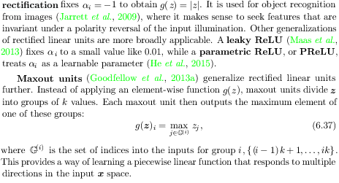
Three generalizations of rectiﬁed linear units are based on using a nonzero
Actual rectification

Slide 34
Logistic Sigmoid and Hyperbolic Tangent : Prior to the introduction of rectiﬁed linear units, most neural networks used the logistic sigmoid activation function g(z) = σ(z)
or the hyperbolic tangent activation function g(z) = tanh(z).
These activation functions are closely related because tanh(z) = 2σ(2z) − 1.
Sigmoidal units saturate across most of their domain—they saturate to a high value when
Z is very positive, saturate to a low value when z is very negative, and are only strongly sensitive to their input when z is near 0.
The widespread saturation of sigmoidal units can make gradient-based learning very diﬃcult.
For this reason, their use as hidden units in feedforward networks is now discouraged

Slide 35
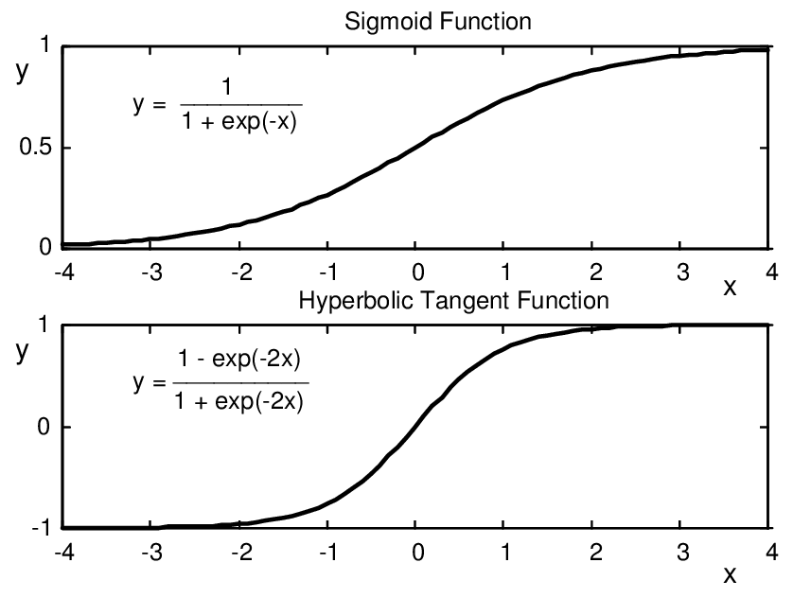
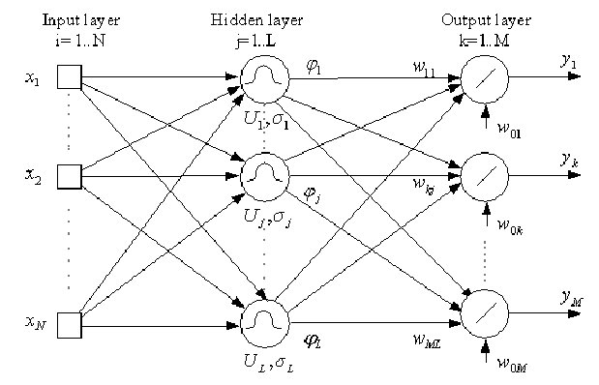

Slide 36

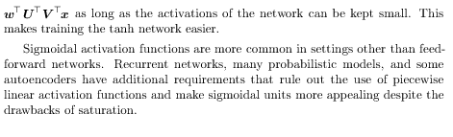

Slide 37
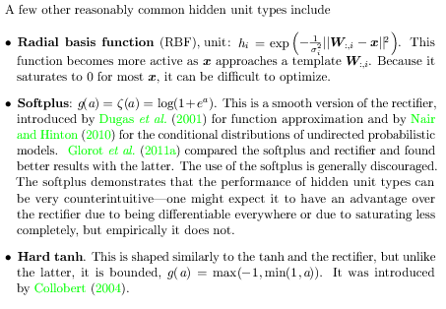

Slide 38
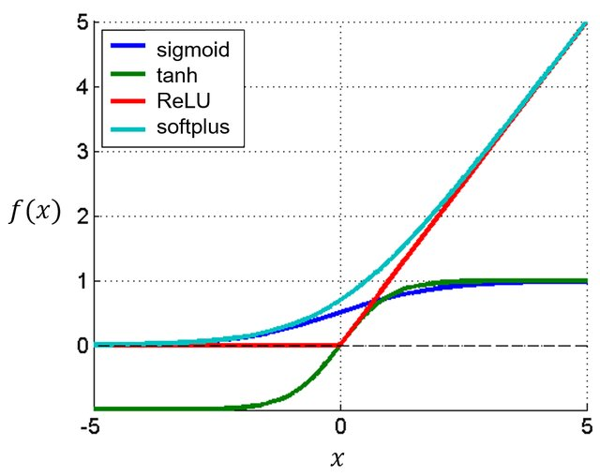
Plot of the sigmoid function, hyperbolic tangent, rectified linear unit layer, and the softplus function. It can be seen that the softplus function is the smooth version of the rectified linear unit layer.

Slide 39
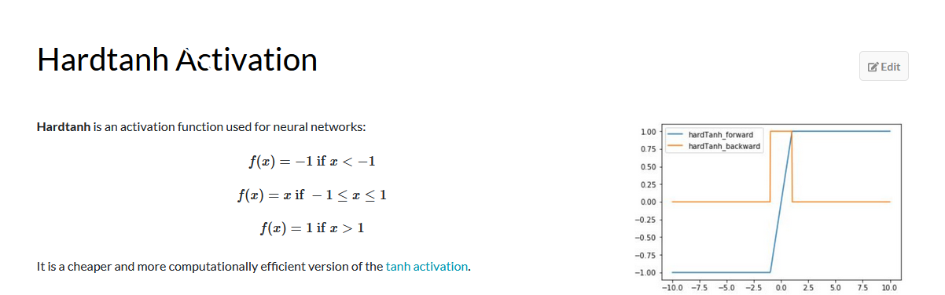

Slide 40
6.4 Architecture Design : The word architecture refers to the overall structure of the network:
how many units it should have and how these units should be connected to each other
Most
neural network architectures arrange these layers in a chain structure, with each
layer being a function of the layer that preceded it. In this structure, the first layer
is given by
the second layer is given by
main architectural considerations are to choose the depth of the network and the width of each layer.
Deeper networks often use fewer units per layer and far fewer parameters and often generalize to the test set, but are also often harder to optimize.
network architecture must be found via experimentation guided by monitoring the validation set error.

Slide 41
the universal approximation theorem (Hornik et al., 1989; Cybenko, 1989) :
states that a feedforward network with a linear output layer and at least one hidden layer with any “squashing” activation function (such as the logistic sigmoid activation function) can approximate any Borel measurable function from one finite-dimensional space to another with any desired non-zero amount of error, provided that the network is given enough hidden units.
The concept of Borel measurability say that any continuous function on a closed and bounded subset of R^{n} is Borel measurable and therefore may be approximated by a neural network.
The universal approximation theorem means that regardless of what function we are trying to learn, we know that a large MLP will be able to represent this function.

Slide 42
Even if the MLP is able to represent the function, learning can fail for two diﬀerent reasons.
First, the optimization algorithm used for training may not be able to ﬁnd the value of the parameters that corresponds to the desired function.
Second, the training algorithm might choose the wrong function as a result of overﬁtting.
There is no universal procedure for examining a training set of speciﬁc examples and choosing a function that will generalize to points not in the training set.
In summary, a feedforward network with a single layer is suﬃcient to represent any function, but the layer may be infeasibly large and may fail to learn and generalize correctly.
In many circumstances, using deeper models can reduce the number of units required to represent the desired function and can reduce the amount of generalization error

Slide 43
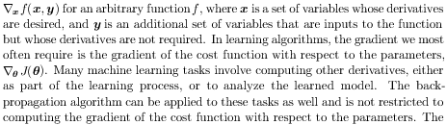
6.5 Back-Propagation and Other Diﬀerentiation Algorithms:
During training, forward propagation can continue onward until it produces a scalar cost J(θ).
The back-propagation algorithm (Rumelhart et al., 1986a), often simply called backprop, allows the information from the cost to then ﬂow backward through the network in order to compute the gradient.
back-propagation refers only to the method for computing the gradient, while another algorithm, such as stochastic gradient descent, is used to perform learning using this gradient.
Speciﬁcally,
we will describe how to compute the gradient

Slide 44
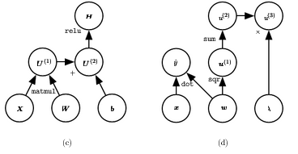
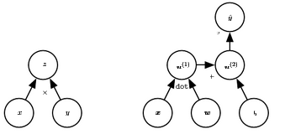
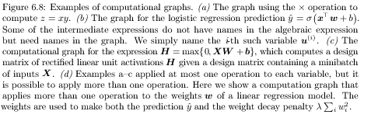
6.5.1 Computational Graphs : To describe the back-propagation algorithm more precisely, it is helpful to have a more precise computational graph language.

Slide 45
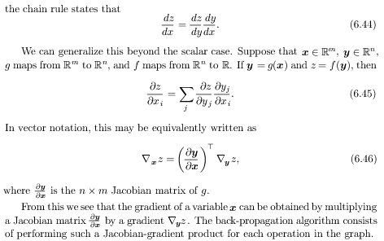
6.5.2 Chain Rule of Calculus

Slide 46
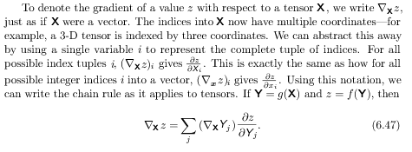

Slide 47
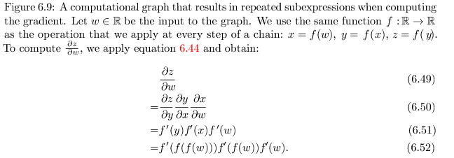
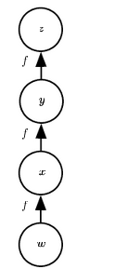
Recursively Applying the Chain Rule to Obtain Backprop

Slide 48
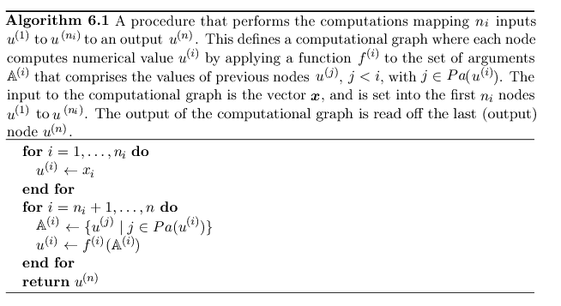

Slide 49

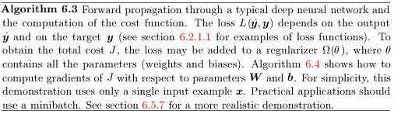

Slide 50
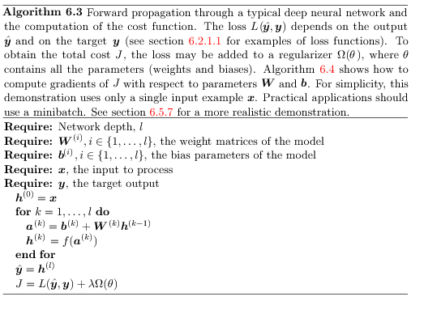
6.5.4 Back-Propagation Computation in Fully Connected MLP

Slide 51
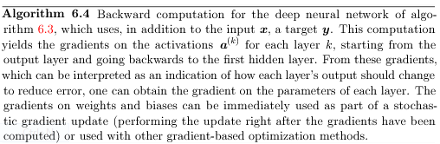
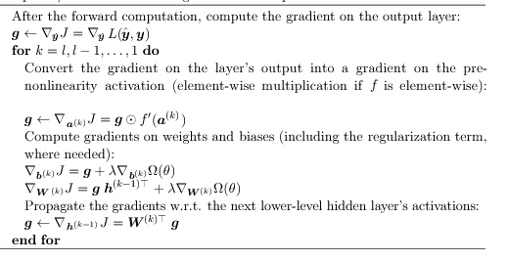

Slide 52
6.5.5 Symbol-to-Symbol Derivative
These algebraic and graph-based representations are called symbolic representations . When we actually use or train a neural network, we must assign speciﬁc values to these symbols. We replace a symbolic input to the network x with a speciﬁc numeric value, such as [1.2, 3.765, −1.8].
Some approaches to back-propagation take a computational graph and a set of numerical values for the inputs to the graph, then return a set of numerical values describing the gradient at those input values. We call this approach symbol-to- number diﬀerentiation

Slide 53

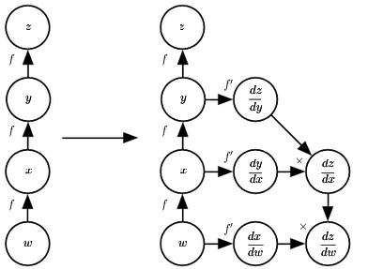

Slide 54
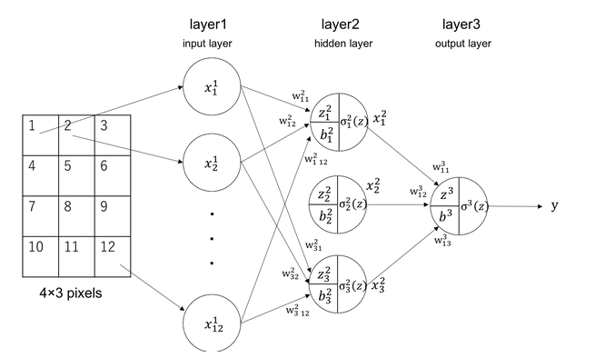

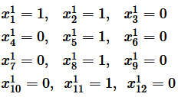
Calculation example of Feed Forward Neural Network

Slide 55
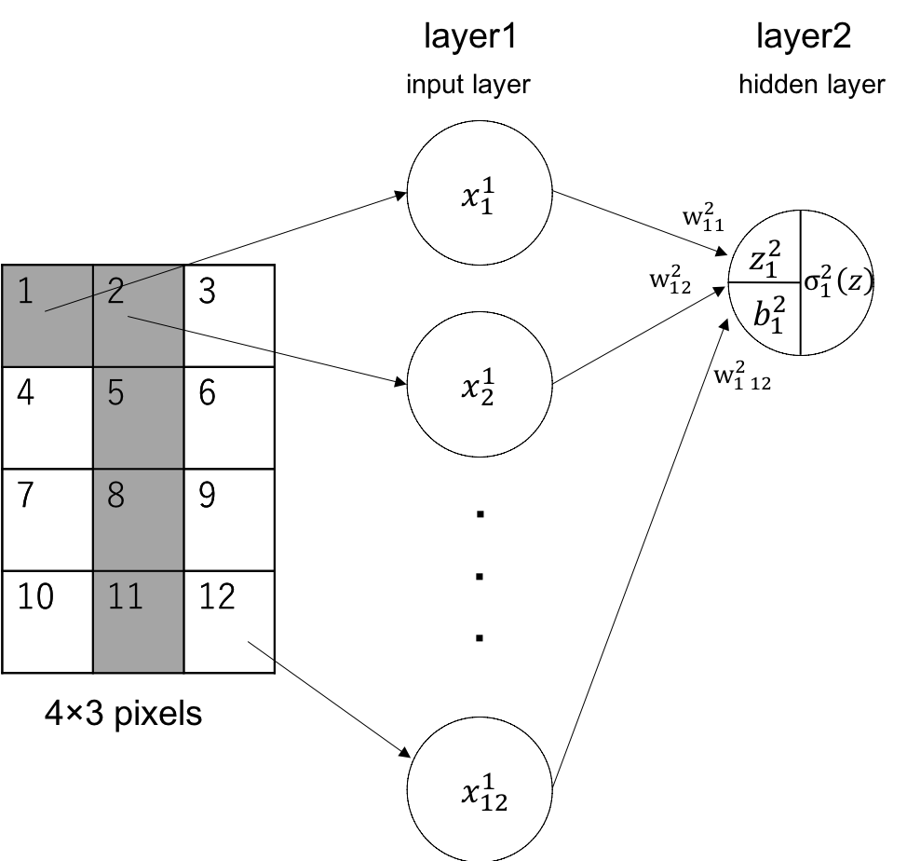

Let’s see how the calculation will go on in unit 1 of layer 2

Slide 56
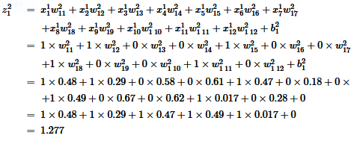
The weighted input would be as follows:

Slide 57
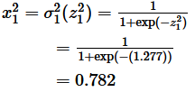
We insert the value into an activation function. We will use sigmoid function for the same reason in section 1. The output of the unit will be,
The same computations are conducted in other units of the neural network.

Slide 58
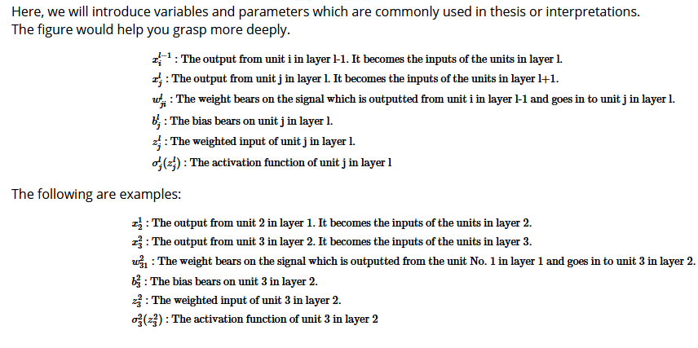

Slide 59
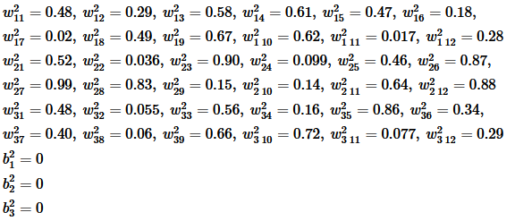
we initialize the weights with random values (0~1) and the bias as 0. Unit 1 of Layer 2 has the same weight as the previous.

Slide 60
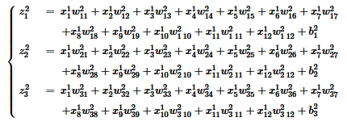
The equations below are the 3 weighted inputs of the hidden layer.

Slide 61
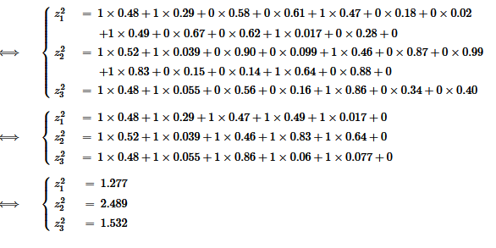
We can perceive each z consisting the same inputs x, but different weights w and bias b. Let’s insert the values to the variables.

Slide 62
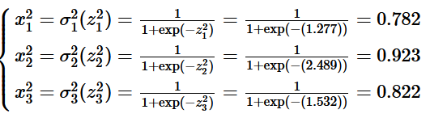
The results shown above are inputs to the activation functions. As mentioned before, we are using sigmoid function. The outputs of the 3 units will become as follows:

Slide 63
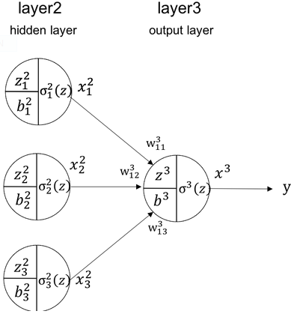
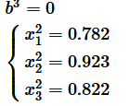
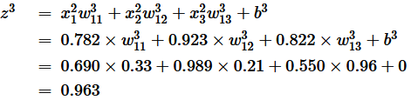
Hidden layer → Output layer
the input for the unit will be as follows:
The weighted input in the output layer will be

Slide 64
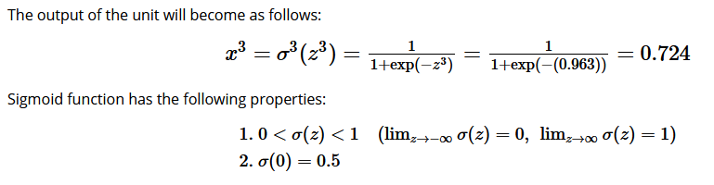

for classification into 2 states, that is, whether “1” was written on the picture or not. In this situation, we can use the following rule for decision as shown below:

Slide 65

Thank You

